Slide 1

Enhancing the Song Recommender Engine
By: Jonathan Chan, Bryan Chen, Geoffrey Liu
Notes:
Slides order:
Geoffrey: Model Overview + Data Exploration + Future Improvements
Bryan: Model Enhancement + Future Improvements
Jonathan: Interaction & Feedback +Future Improvements

Slide 2
Original Model Overview
The original song recommender engine uses a K-Means clustering algorithm that creates 5 clusters. The model predicts which cluster the user is most likely to prefer based on their favorite songs, and recommends the first 5 songs in the cluster.
When a user inputs the IDs of their favorite songs, the song recommender engine filters the DataFrame to retrieve the user's favorite songs. The engine then identifies the cluster that most of the user's favorite songs belong to by counting the occurrences of each cluster number in the 'type' column of the user's favorite songs. The cluster with the highest frequency becomes the user's preferred cluster.

Slide 3
Data Exploration

Slide 4
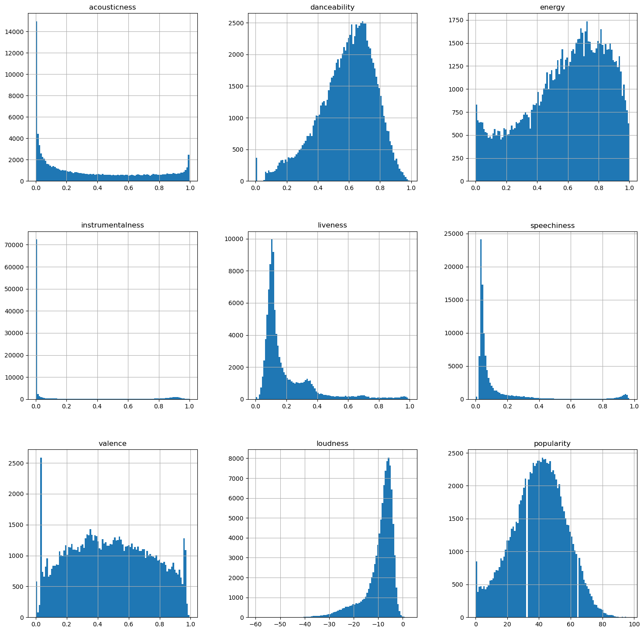
Visualizations - Histogram
Some observations :
High frequency of songs have low ‘Instrumentalness’, meaning if the user is looking for songs with a heavy focus on the instrumental, the choices may be more limited.
Valence has two obvious clusters on either end of the graph, which show that there are many very sad and very happy songs.

Slide 5
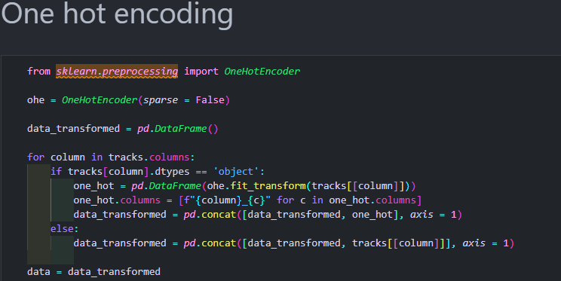
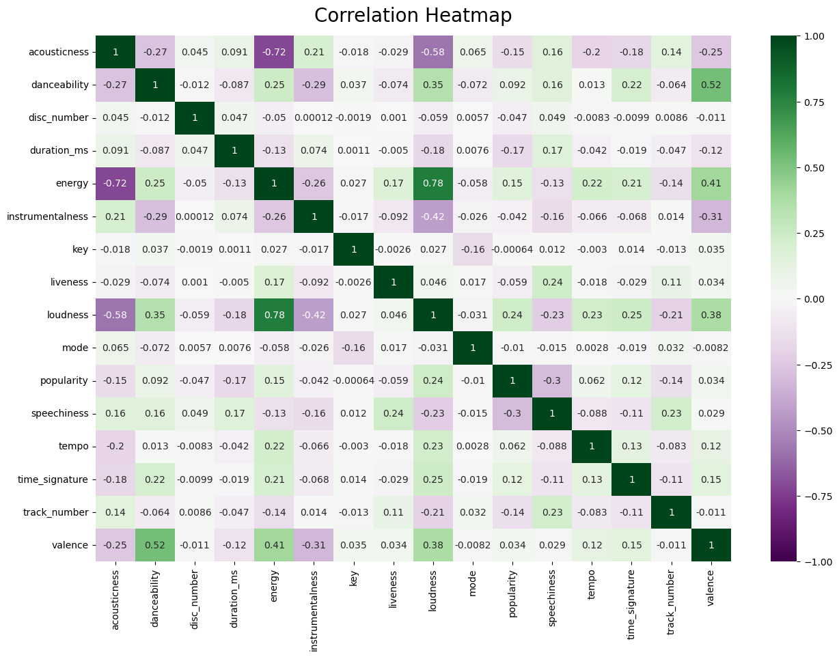
Visualizations – Correlation Heatmap
Acousticness has a strong negative correlation with energy. This shows that acoustic songs tend to have lower energy.
Valence is positively correlated with danceability, energy, and loudness. This shows that happier songs tend to be easier to dance to, more high-energy, and louder.
Popularity is not closely correlated with any of the variables, which show that Spotify has a diverse user base with people enjoying several types of music and that all types of music can be popular.

Slide 6
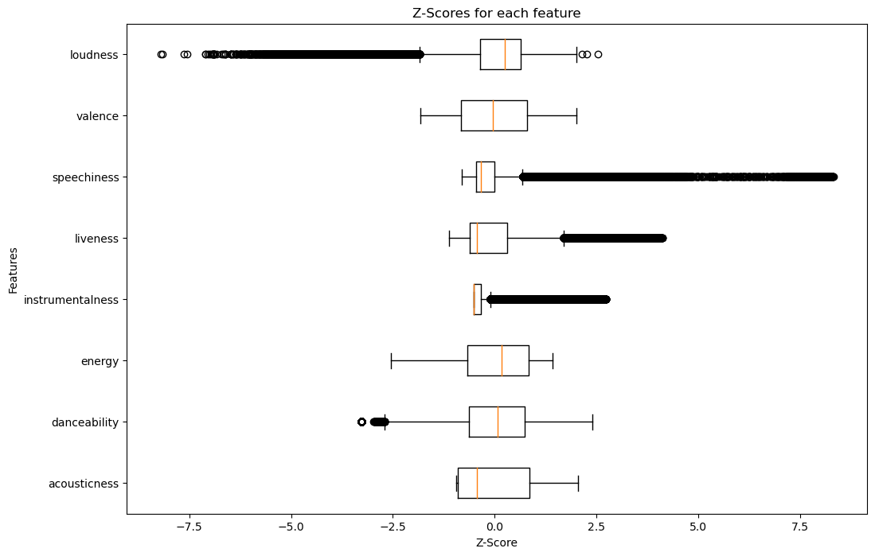
Visualizations 3 - Z-Score Distribution
Some observations :
The boxplot for ‘Loudness’ has many low outliers. This shows that while songs tend to be at a certain loudness, many songs are below that loudness.
The boxplot for ‘Energy’ has no outliers. This shows that energy is rather evenly distributed in Spotify songs.
Notes:
For future use:

Slide 7
Model Enhancement

Slide 8
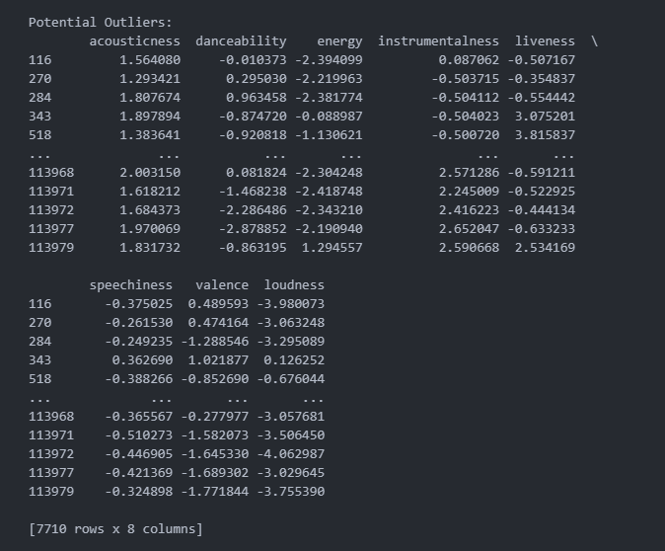
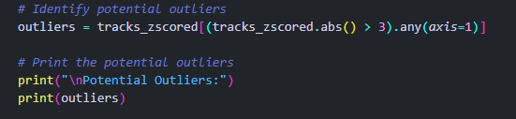
Handling Outliers
In order to handle the outliers, we implemented z-score normalization as a preprocessing step before applying the K-Means clustering algorithm. By standardizing the data through z-score, we ensure that all the features have a mean of 0 and a standard deviation of 1. See Visualization 3 for the z-score distribution.
Notes:
The code filters the z-scored tracks data to isolate rows containing outlier values, where the absolute z-scores are greater than 3 or less than -3.

Slide 9
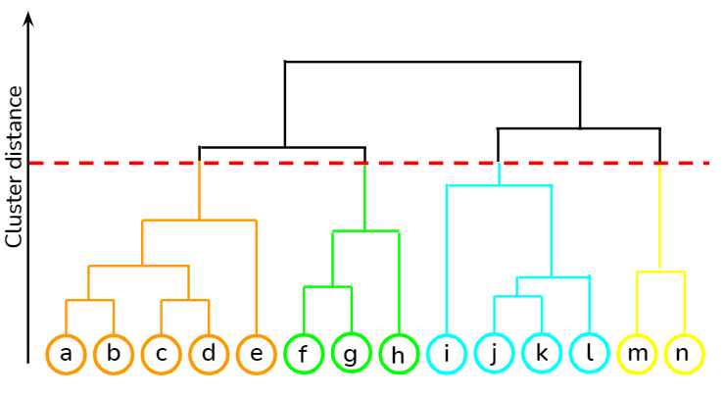
Other Clustering Algorithms
When comparing to KMeans, Hierarchical clustering offers a more detailed representation of data relationships by creating nested clusters. It splits song types based on their traits which is appropriate for different music genres. However, we found that its computational power limits its real-time applicability due to the high RAM it was needed to run for a large database like this one. Overall, KMeans was better.
Hierarchical Clustering

Slide 10
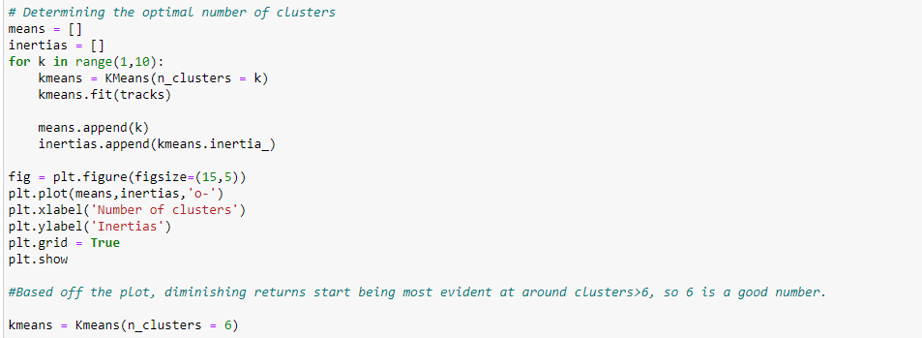
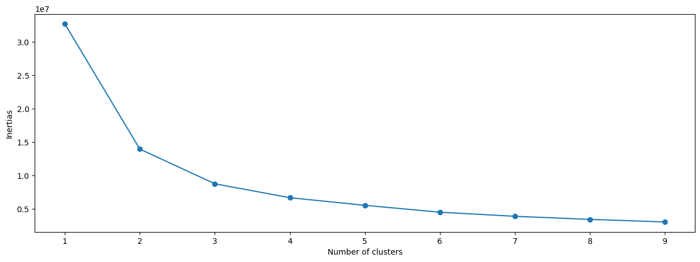
Number of Clusters
The optimal number of clusters was found through adding this section of code to plot the inertias:
Result :
Inertias = sums of distance between plots and cluster (generally, the lower inertia the better, but if the inertia is too low the model may be overfitted.)

Slide 11
User Interaction & Feedback

Slide 12

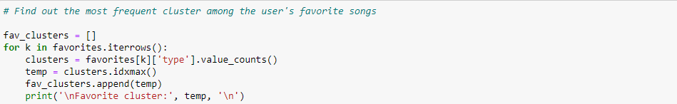
Improving Inputs & Recommendations
The user is able to input multiple song IDs at once, each ID being separated by a comma.
These IDs are stored within a list which we would call ‘favorites’
Our code identifies the user’s favorite cluster for each song by iterating through ‘favorites’, giving us multiple clusters to search through.
The code then outputs multiple songs from each identified cluster as ‘recommendations’.

Slide 13
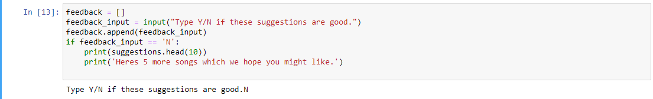
Future Uses for User Feedback
User feedback is stored in a list for future purposes (To see ratio of Y/N and improve model)
In the case that the user is unhappy with the model, we can suggest 5 more songs.
If N>Y, then we can improve model through a variety of ways such as: Changing number of clusters, changing parameters in ‘tracks’, etc.

Slide 14
Future Improvements

Slide 15
Future Improvements
When selecting relevant features, features such as ‘lyrics’ are difficult to analyze and be used as it is not numerical and are long string values. A future improvement could be to somehow implement this into our code as well. For example, analyzing the patterns of the words used in the lyrics can provide valuable information into user’s favourite songs.
Genre tags on songs can also be used as data in the future to help in identifying clusters. By using genre information, the engine can better understand the context of each song, which will lead to more accurate clustering.
Creating a UI using elements such as HTML for a more comprehensible and user-friendly format will be much more appealing and effective to use for the average user.
Improve runtime

